Slide 1

NSG Pilkington – University of Liverpool Machine Learning Project: 09/12/2020
Dr. Peter Green
Diego Echeverria
Risk Institute,
School of Engineering

Slide 2
List of activities
The parameters in the pre-processing pipeline boxes can now be tuned.
Run the pre-processing tasks defined in the flow chart with the 170 inputs specified in the spreadsheet “UK5 AI Furnace Model Input Pre-Processing”.
Investigate the model’s targets using the information provided in the file “20201202 ISRA-5D 20190801 to 20200322.xlsx”

Slide 3
List of activities
The parameters in the pre-processing pipeline boxes can now be tuned.
Run the pre-processing tasks defined in the flow chart with the 170 inputs specified in the spreadsheet “UK5 AI Furnace Model Input Pre-Processing”.
Investigate the model outputs using the information provided in the file “20201202 ISRA-5D 20190801 to 20200322.xlsx”

Slide 4
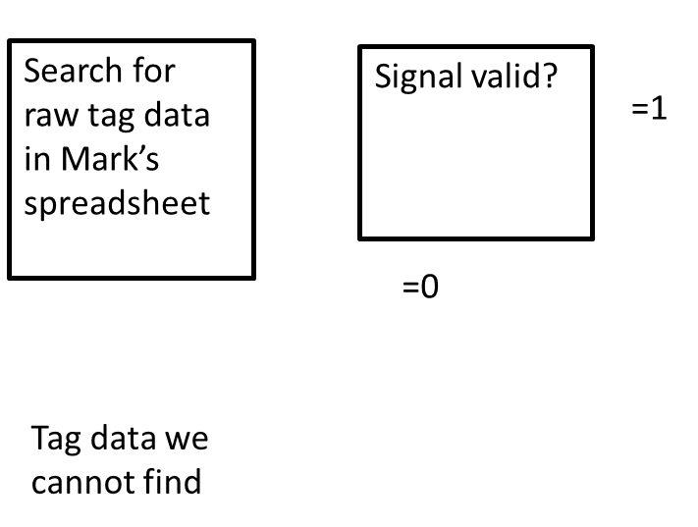
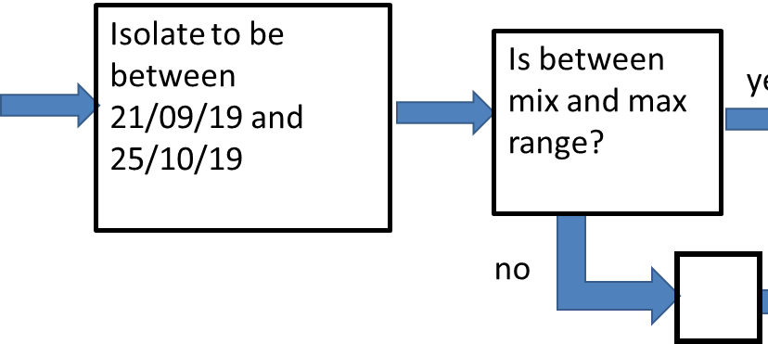
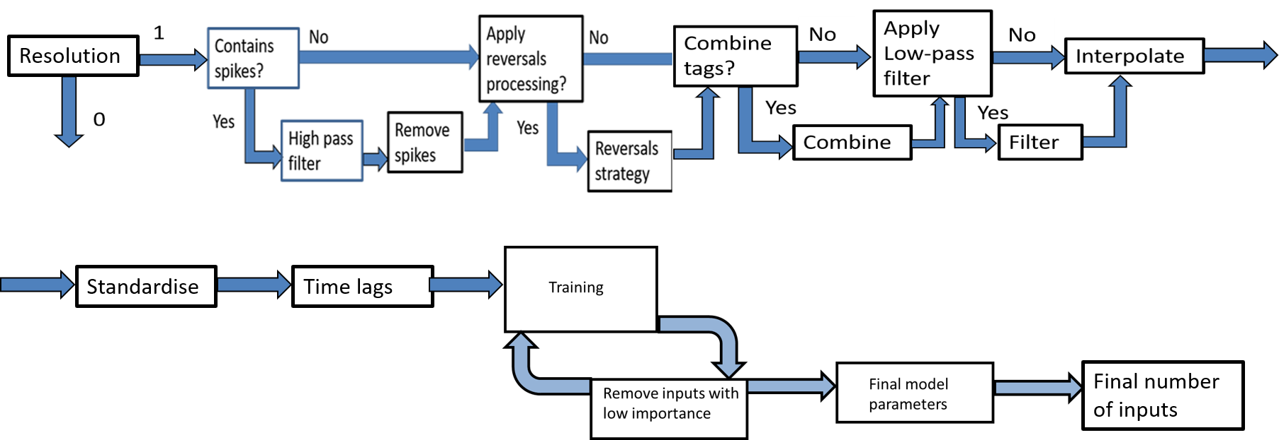
Pipeline 10
& Enable?
Yes
Read time lags

Slide 5
Pipeline 10
& Enable?
Yes
Read time lags

Slide 6
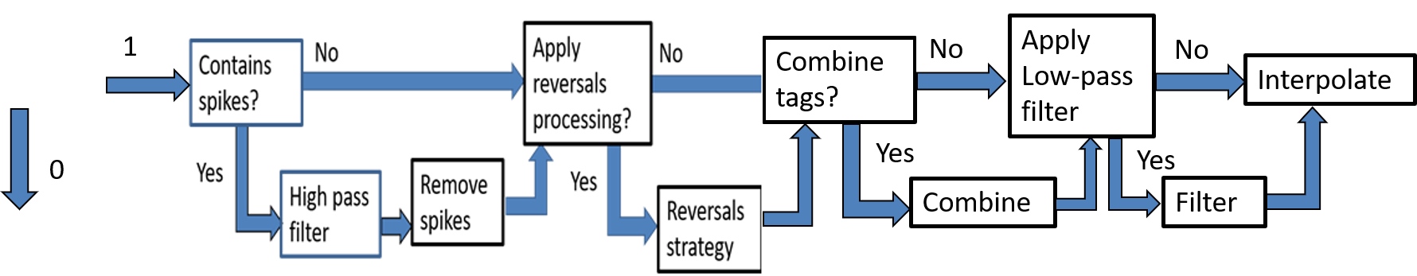
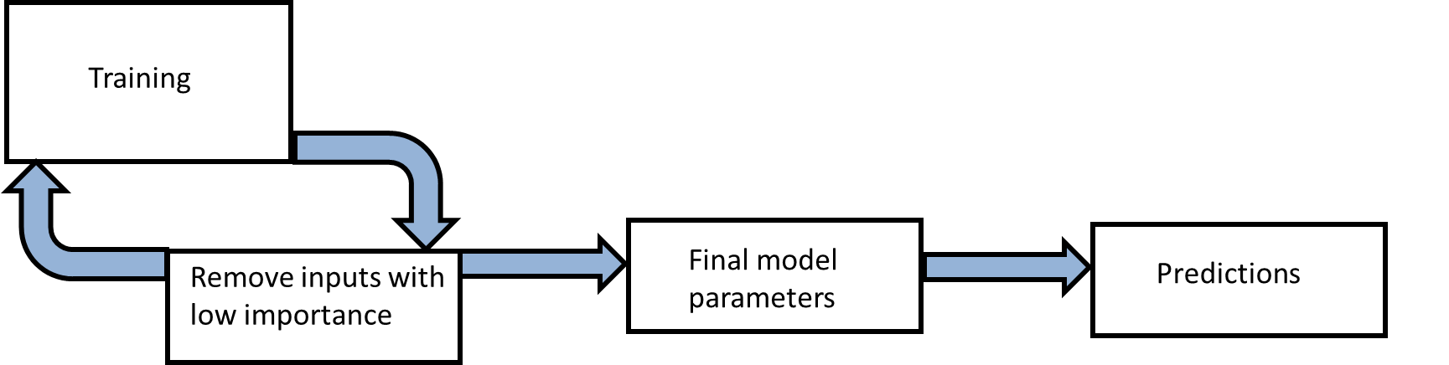
We have implemented the Machine Learning section on the general structure of the pipeline
Resolution
Standardise
Time lags
Final number of inputs

Slide 7
Pipeline 10: Some pre-processing units can now be tuned
& Enable?
Yes
Read time lags

Slide 8
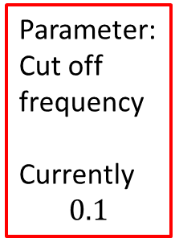
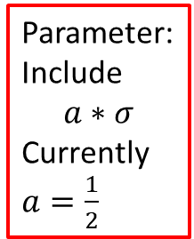
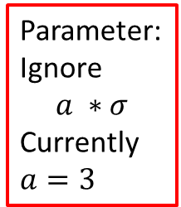
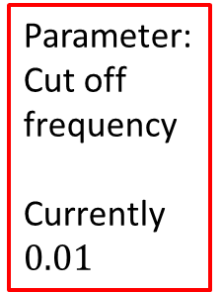
Pipeline 10: Some pre-processing units can now be tuned
Resolution
Parameter: Cut off frequency
Currently $0.01$
Parameter:
Ignore
$$a ∗σ$$
Currently $a=3$
Parameter:
Include
$$a∗σ$$
Currently $a=\frac{1}{2}$
Parameter:
Cut off frequency
Currently
$$0.1$$

Slide 9
Pipeline 10: Ignoring inputs if their corresponding parameters are always below a parameter $a$
& Enable?
Yes
Read time lags

Slide 10

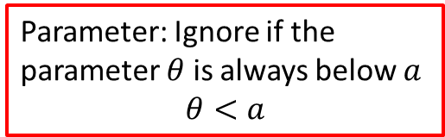
Pipeline 10: Ignoring inputs if their corresponding parameters are always below a parameter $a$
Standardise
Time lags
Final number of inputs
Parameter: Ignore if the parameter $θ$ is always below $a$
$$θ<a$$

Slide 11
List of activities
The parameters in the pre-processing pipeline boxes can now be tuned.
Run the pre-processing tasks defined in the flow chart with the 170 inputs specified in the spreadsheet “UK5 AI Furnace Model Input Pre-Processing”.
Investigate the model outputs using the information provided in the file “20201202 ISRA-5D 20190801 to 20200322.xlsx”

Slide 12
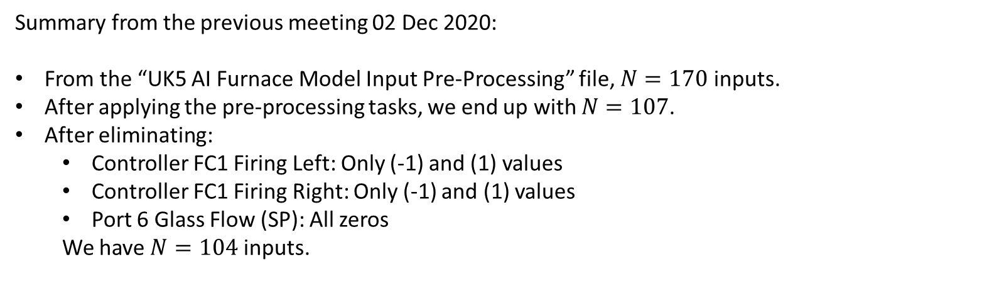
Summary from the previous meeting
Summary from the previous meeting 02 Dec 2020:
From the “UK5 AI Furnace Model Input Pre-Processing” file, $N=170$ inputs.
After applying the pre-processing tasks, we end up with $N=107$.
After eliminating:
Controller FC1 Firing Left: Only (-1) and (1) values
Controller FC1 Firing Right: Only (-1) and (1) values
Port 6 Glass Flow (SP): All zeros
We have $N=104$ inputs.

Slide 13
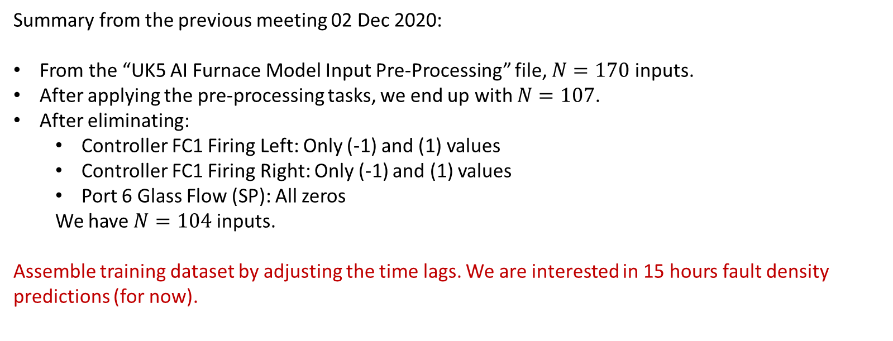
Adjust time lags
Summary from the previous meeting 02 Dec 2020:
From the “UK5 AI Furnace Model Input Pre-Processing” file, $N=170$ inputs.
After applying the pre-processing tasks, we end up with $N=107$.
After eliminating:
Controller FC1 Firing Left: Only (-1) and (1) values
Controller FC1 Firing Right: Only (-1) and (1) values
Port 6 Glass Flow (SP): All zeros
We have $N=104$ inputs.
Assemble training dataset by adjusting the time lags. We are interested in 15 hours fault density predictions (for now).

Slide 14
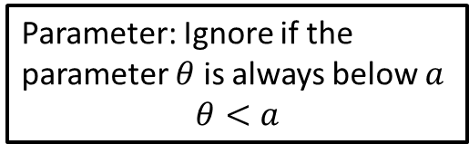
Pipeline 10
Standardise
Time lags
Final number of inputs
Parameter: Ignore if the parameter $θ$ is always below $a$
$$θ<a$$

Slide 15
Processing lagged tag data to be used as inputs
Adjust for time lags…
Max lag
Fault
Density
future pred
Time
Tag 1
Lag 1 + future pred
Time
Tag 2
Lag 2 + future pred
Time
Now

Slide 16
Processing lagged tag data to be used as inputs
Remove data where we can’t realise predictions
Max lag
Fault
Density
future pred
Time
Tag 1
Time
Tag 2
Time
Now

Slide 17
Processing lagged tag data to be used as inputs
Left with input-output pairs for training etc.
Max lag
Fault
Density
future pred
Time
Tag 1
Time
Tag 2
Time
Now

Slide 18
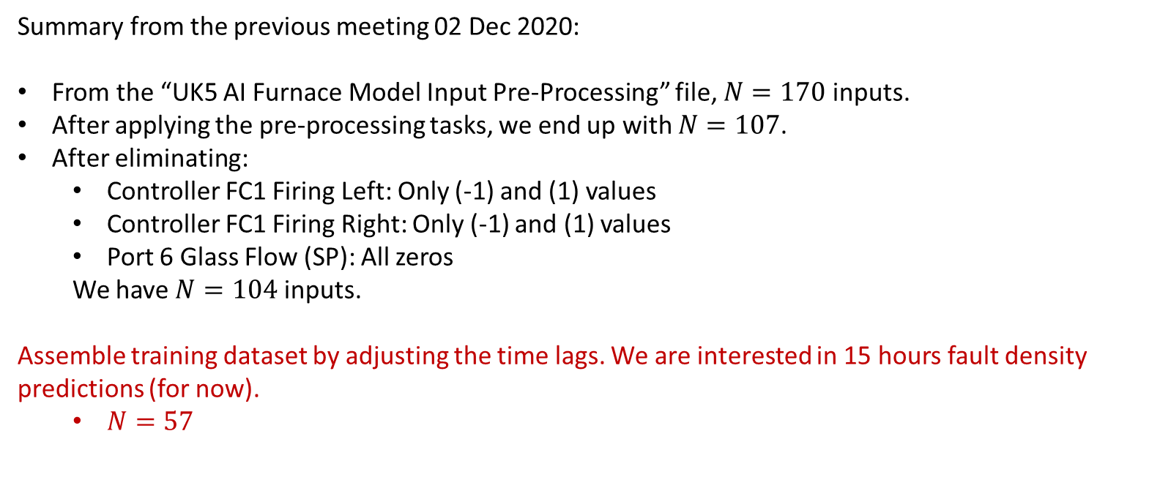
N of inputs after adjusting the time lags
Summary from the previous meeting 02 Dec 2020:
From the “UK5 AI Furnace Model Input Pre-Processing” file, $N=170$ inputs.
After applying the pre-processing tasks, we end up with $N=107$.
After eliminating:
Controller FC1 Firing Left: Only (-1) and (1) values
Controller FC1 Firing Right: Only (-1) and (1) values
Port 6 Glass Flow (SP): All zeros
We have $N=104$ inputs.
Assemble training dataset by adjusting the time lags. We are interested in 15 hours fault density predictions (for now).
$N=57$

Slide 19
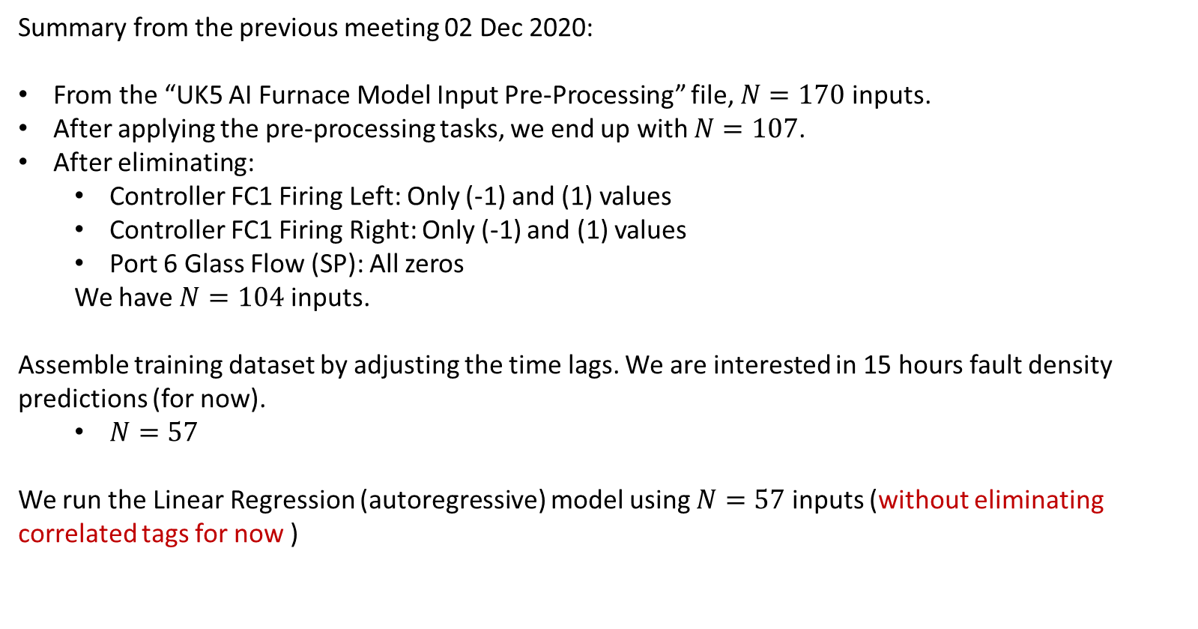
N of inputs after adjusting the time lags
Summary from the previous meeting 02 Dec 2020:
From the “UK5 AI Furnace Model Input Pre-Processing” file, $N=170$ inputs.
After applying the pre-processing tasks, we end up with $N=107$.
After eliminating:
Controller FC1 Firing Left: Only (-1) and (1) values
Controller FC1 Firing Right: Only (-1) and (1) values
Port 6 Glass Flow (SP): All zeros
We have $N=104$ inputs.
Assemble training dataset by adjusting the time lags. We are interested in 15 hours fault density predictions (for now).
$N=57$
We run the Linear Regression (autoregressive) model using $N=57$ inputs (without eliminating correlated tags for now )

Slide 20
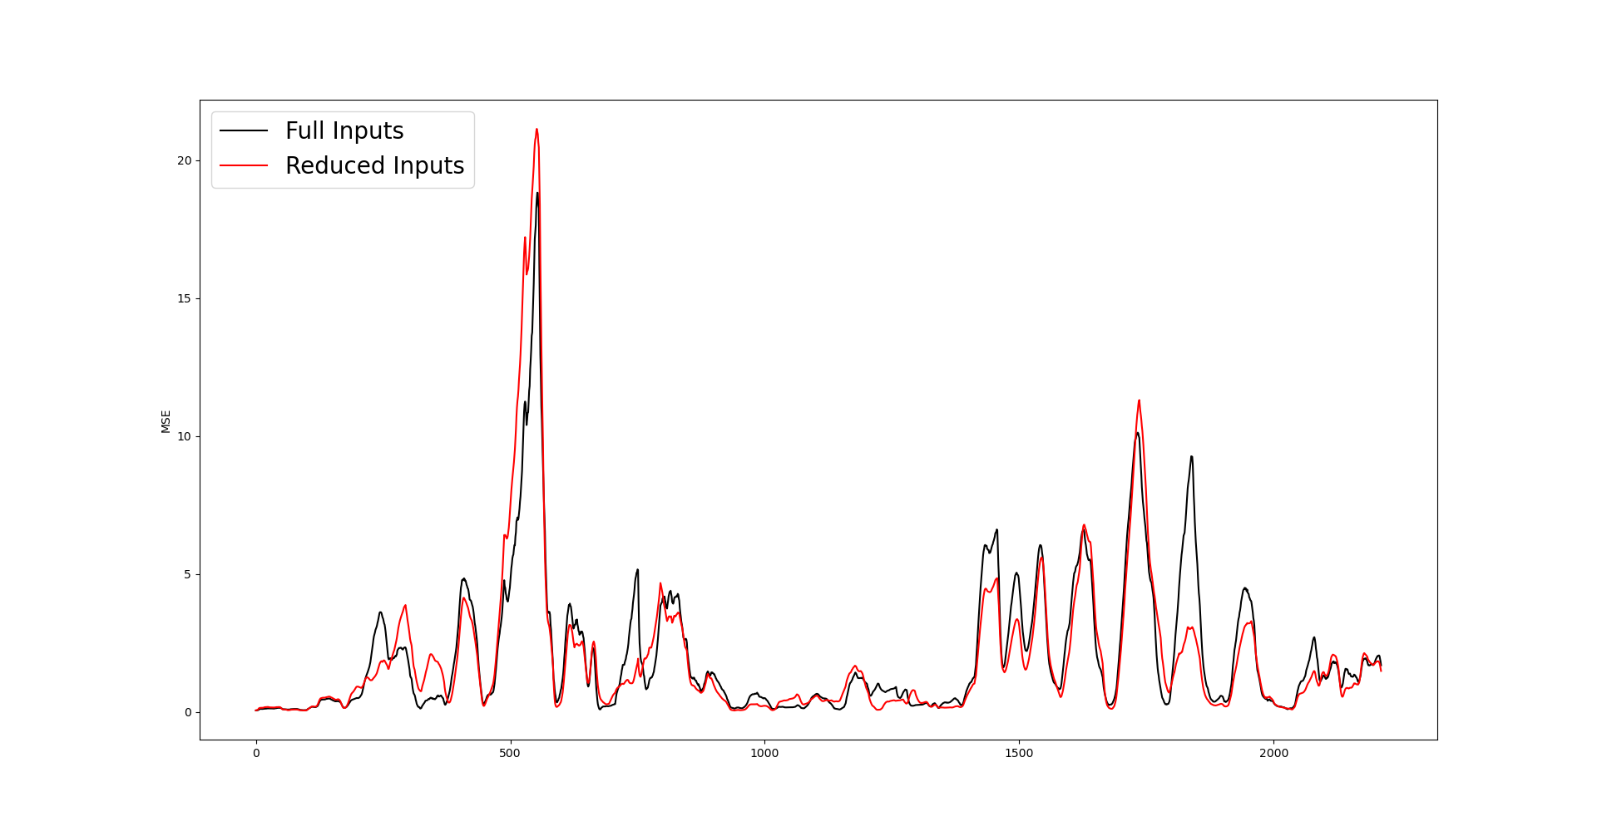
MSE plot of the Linear Regression model (Autoregressive)

Slide 21
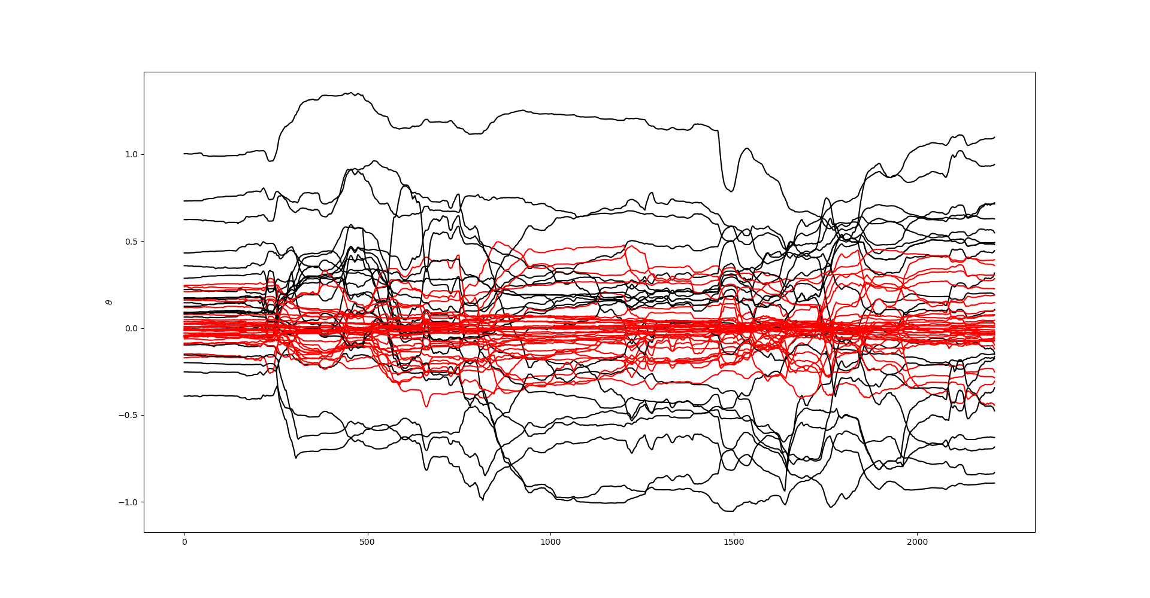
The parameters (how they change) of the eliminated tags are shown in red

Slide 22
The parameters (how they change) of the eliminated tags are shown in red
35 tags were eliminated:
10278 Canal Temp. Control (OP)
10279 Canal Temp. Control (PV)
2908 Closed Bottom Temperature - Mid Refiner (PV)
2916 Closed Bottom Temperature - Port 4 (PV)
2907 Closed Bottom Temperature - Upstream Refiner (PV)
2921 Closed Bottom Temperature - Upstream Working End (PV)
1650 Combustion Air Temperature Measurement
2910 Crown Temp Meas 4m D/S No.8 Port C/L
11152 D/S Working End Cooling Air Flow Control Right (OP)
5134 EEDS Average Gross Width Measurement
11213 Essential Services Board Cat 'B' Supply - MV53
2923 Filling Pocket Closed Bottom Temperature Centre (PV)
2911 Filling Pocket Closed Bottom Temperature LHS (PV)
2912 Filling Pocket Closed Bottom Temperature RHS (PV)
5288 Front Wall Cooling Air Flow (PV)
11201 Furnace & Services Pack Sub S8 L.H. Section - HV13
11174 Furnace Bottom Temperature 18m D/S of B8
31037 Furnace Gas Flow Measurement
9403 Furnace Pressure (OP)
15119 Furnace Pressure (PV)
321 Glass Level Control (PV)
7474 Lehr Drive Line Shaft Speed
11211 MV51
7485 Open Crown Temperature - Downstream Refiner (PV)
7945 Open Crown Temperature - Downstream Working End (PV)
7546 Open Crown Temperature - Port 1 (PV)
7746 Open Crown Temperature - Port 2 (PV)
7548 Open Crown Temperature - Port 3 (PV)
7522 Open Crown Temperature - Port 4 (PV)
7673 Open Crown Temperature - Port 5 (PV)
7483 Open Crown Temperature - Port 6 (PV)
7525 Open Crown Temperature - Port 7 (PV)
11148 Open Crown Temperature - Port 8 (PV)
31137 Open Crown Temperature - Upstream Refiner (OP)
7520 Open Crown Temperature - Upstream Working End (PV)

Slide 23
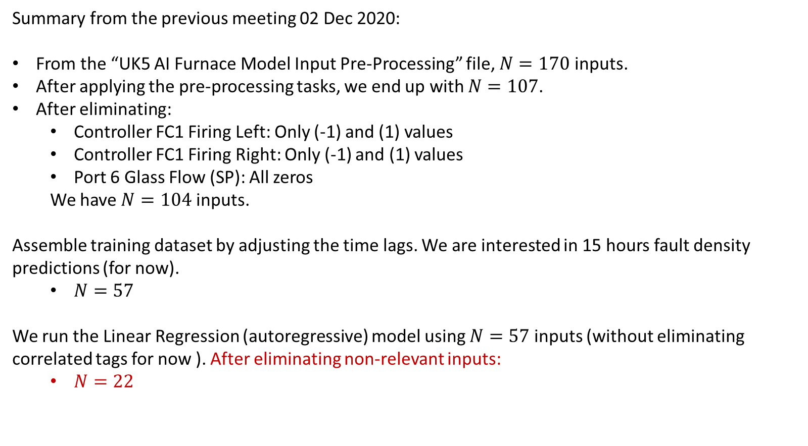
N of inputs after eliminating non-relevant tags
Summary from the previous meeting 02 Dec 2020:
From the “UK5 AI Furnace Model Input Pre-Processing” file, $N=170$ inputs.
After applying the pre-processing tasks, we end up with $N=107$.
After eliminating:
Controller FC1 Firing Left: Only (-1) and (1) values
Controller FC1 Firing Right: Only (-1) and (1) values
Port 6 Glass Flow (SP): All zeros
We have $N=104$ inputs.
Assemble training dataset by adjusting the time lags. We are interested in 15 hours fault density predictions (for now).
$N=57$
We run the Linear Regression (autoregressive) model using $N=57$ inputs (without eliminating correlated tags for now ). After eliminating non-relevant inputs:
$N=22$

Slide 24
Relevant inputs N = 22
'10425 Calculated Cullet Ratio',
'2909 Closed Bottom Temperature - Downstream Refiner (PV)',
'2908 Closed Bottom Temperature - Mid Refiner (PV)',
'2916 Closed Bottom Temperature - Port 4 (PV)',
'2918 Closed Bottom Temperature - Port 6 (PV)',
'1672 Closed Bottom Temperature - Port 8 (PV)',
'2907 Closed Bottom Temperature - Upstream Refiner (PV)',
'2911 Filling Pocket Closed Bottom Temperature LHS (PV)',
'2912 Filling Pocket Closed Bottom Temperature RHS (PV)',
'11201 Furnace & Services Pack Sub S8 L.H. Section - HV13',
'10091 Furnace Load', '7525 Open Crown Temperature - Port 7 (PV)',
'11148 Open Crown Temperature - Port 8 (PV)',
'10271 Open Crown Temperature - Upstream Refiner (PV)',
'9402 Port 1 Gas Flow (SP)', '9398 Port 3 Gas Flow (SP)',
'11120 Port 4 - 5 Combustion Air Flow RHS (OP)',
'7667 Port 7 Gas Flow (PV)', '9502 Port 7 Gas Flow (SP)',
'11136 Port 8 Gas Flow (PV)', '11137 Port 8 Gas Flow (SP)',
'11217 Services Building MCC9 Cat 'B' Supply - MV60'

Slide 25
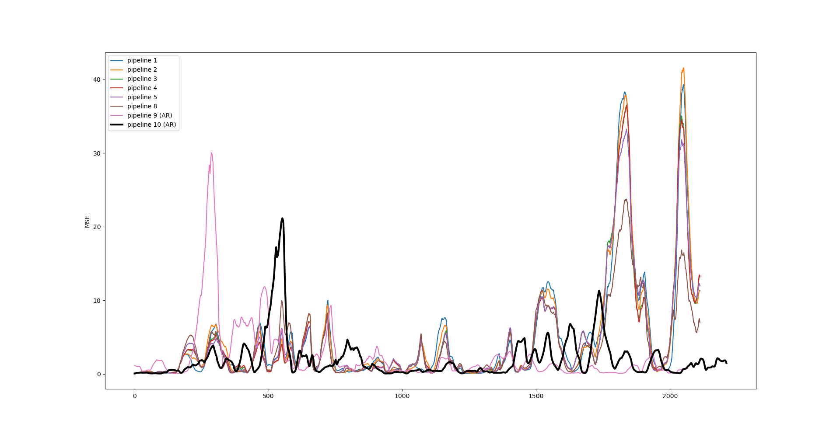
MSE plot comparisons
Pipeline | Av. MSE
1 | 4.59
2 | 4.70
3 | 4.31
4 | 4.30
5 | 4.31
6 | 4.50
7 | 4.27
8 | 4.25
9 | 4.18
9 (AR) | 2.39
10 (AR) | 1.99
First MSE plot using the ‘new’ input data

Slide 26
List of activities
The parameters in the pre-processing pipeline boxes can now be tuned.
Run the pre-processing tasks defined in the flow chart with the 170 inputs specified in the spreadsheet “UK5 AI Furnace Model Input Pre-Processing”.
Investigate the model’s targets using the information provided in the file “20201202 ISRA-5D 20190801 to 20200322.xlsx”

Slide 27
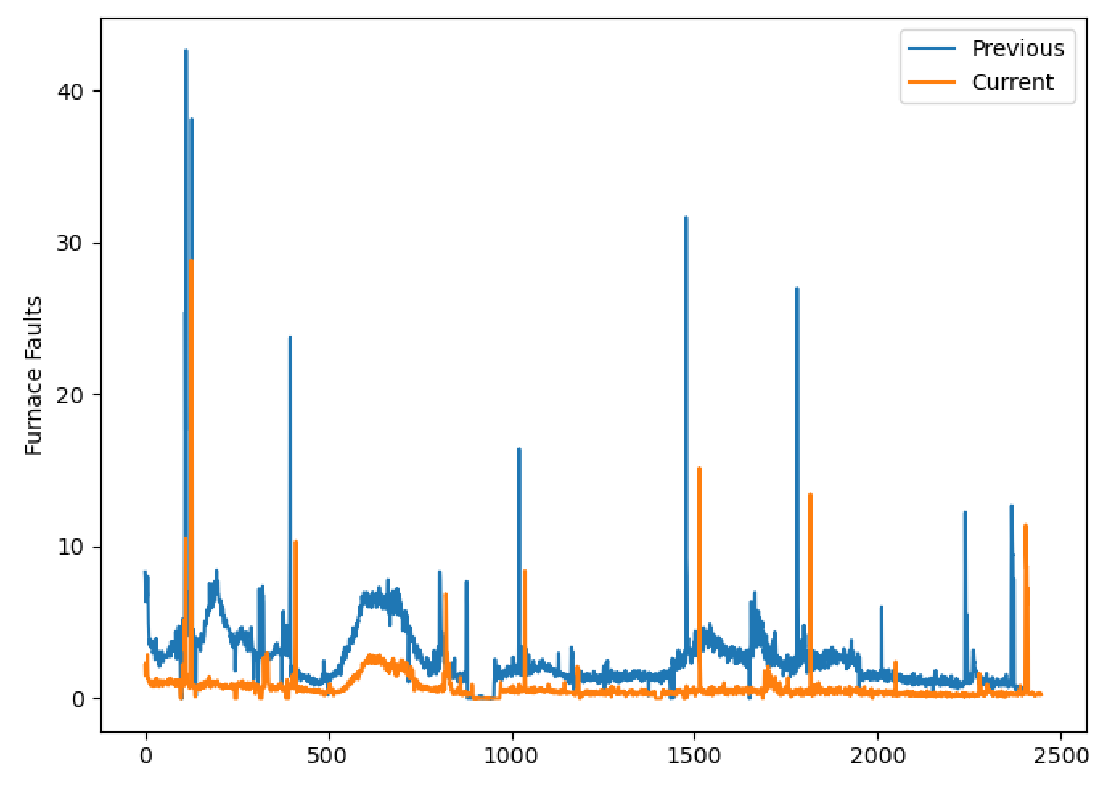
Previous and Current measures of Fault Density (Pre-processed)

Slide 28
Previous and Current measures of Fault Density (Pre-processed)
Not much to ‘test’ the model here?
We will end up validating the model on many other datasets so probably not a huge issue, but worth bearing in mind.
A lot of the ‘interesting stuff’ is in the region where, typically, the model is still learning.

Slide 29
Furnace Fault Pipeline
Isolate to be between 21/09/19 and 25/10/29
20201202 ISRA-5D 20190801 to 20200322.xlsx
Remove spikes
Low pass filter
High pass filter
Spike locations

Slide 30
Furnace Fault Pipeline
Low pass filter parameters
Isolate to be between 21/09/19 and 25/10/29
20201202 ISRA-5D 20190801 to 20200322.xlsx
Remove spikes
Low pass filter
High pass filter
Spike locations
High pass filter parameters
Outlier definition

Slide 31
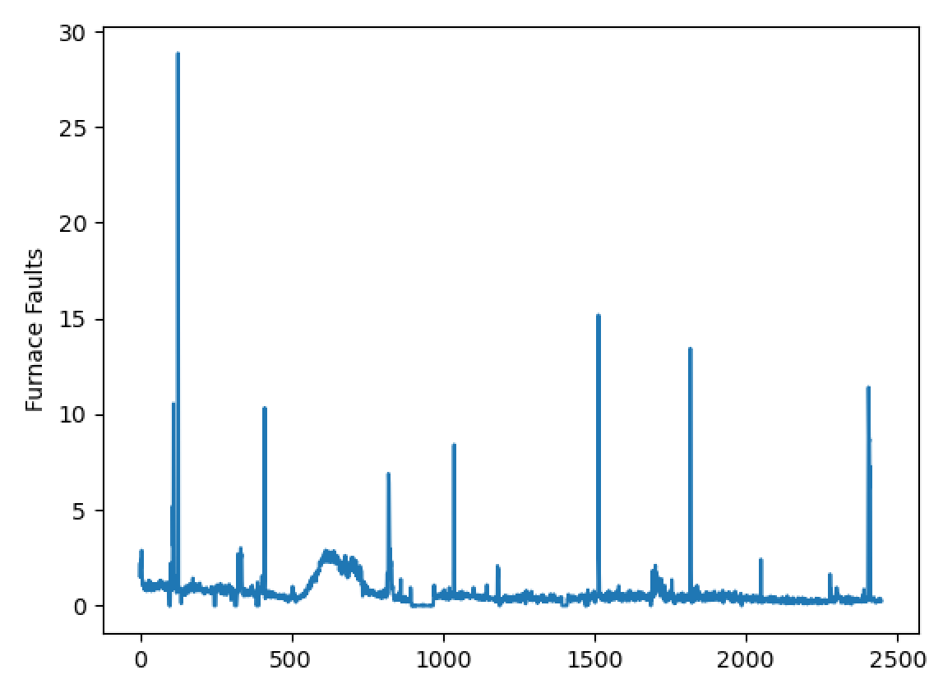
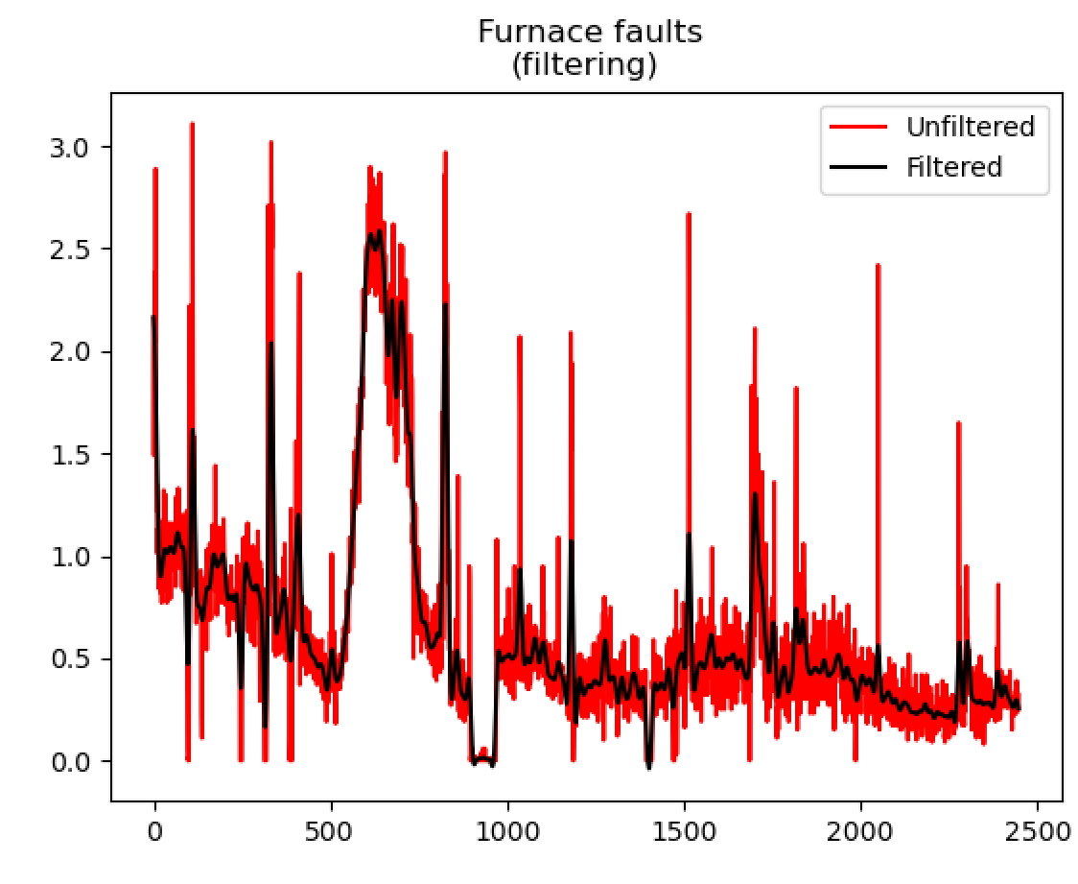
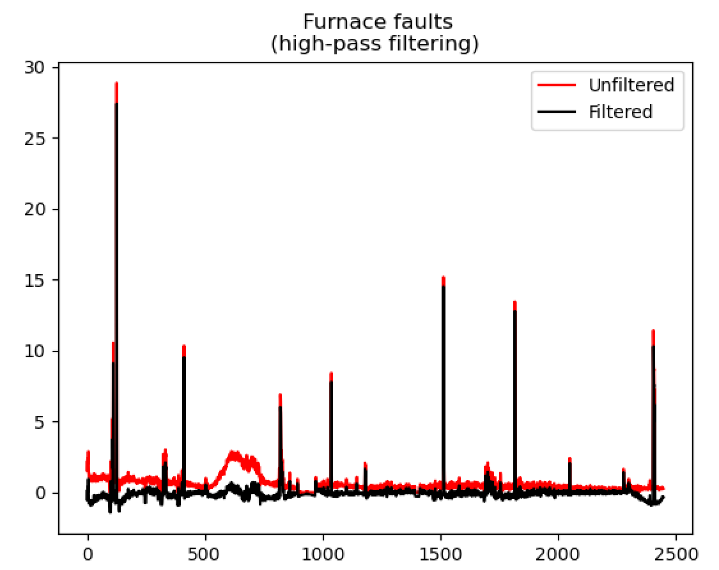
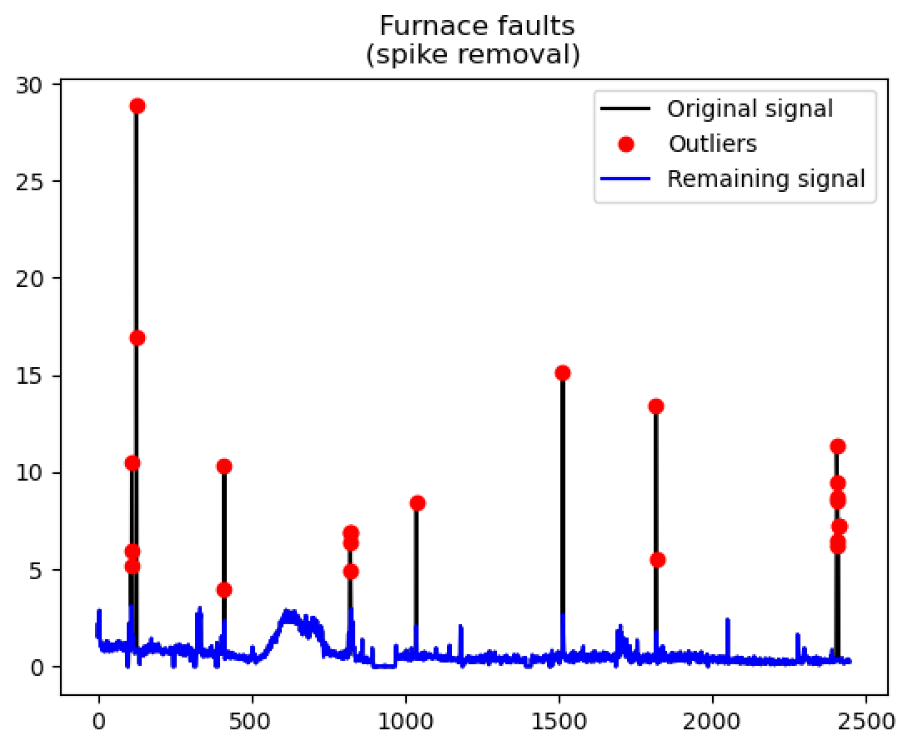
Furnace Fault Pipeline
Isolate to be between 21/09/19 and 25/10/29
20201202 ISRA-5D 20190801 to 20200322.xlsx
Remove spikes
Low pass filter
High pass filter
Spike locations

Slide 32
Current measures of Fault Density (post-processed)

Slide 33
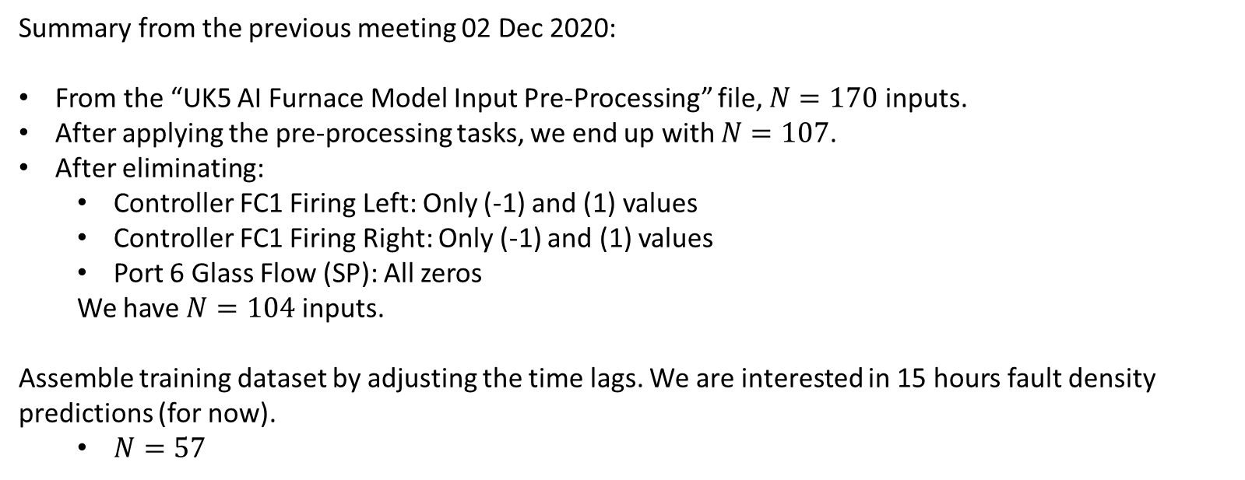
We train the model N = 57 inputs and the new set of outputs
Summary from the previous meeting 02 Dec 2020:
From the “UK5 AI Furnace Model Input Pre-Processing” file, $N=170$ inputs.
After applying the pre-processing tasks, we end up with $N=107$.
After eliminating:
Controller FC1 Firing Left: Only (-1) and (1) values
Controller FC1 Firing Right: Only (-1) and (1) values
Port 6 Glass Flow (SP): All zeros
We have $N=104$ inputs.
Assemble training dataset by adjusting the time lags. We are interested in 15 hours fault density predictions (for now).
$N=57$

Slide 34
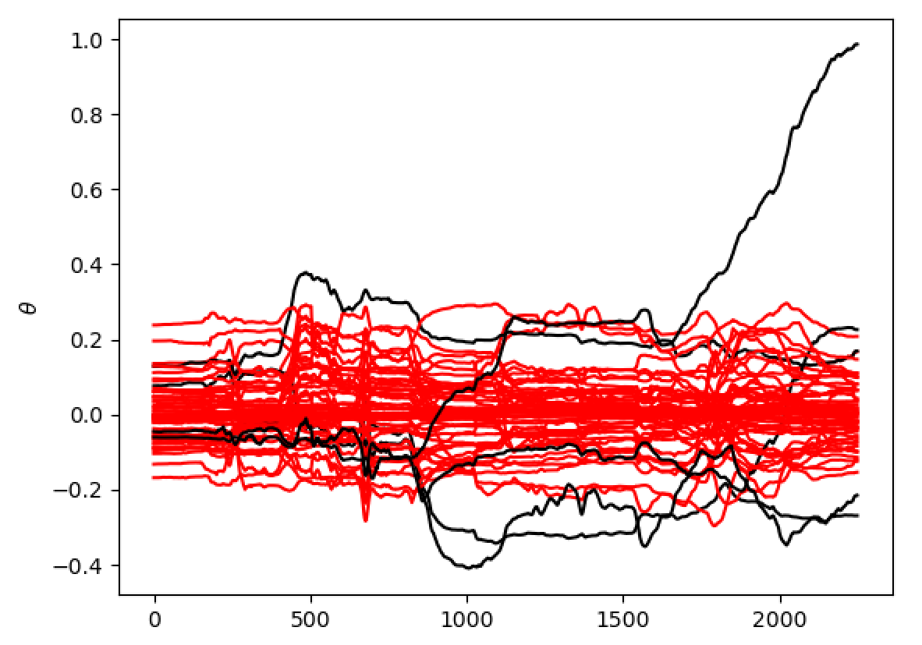
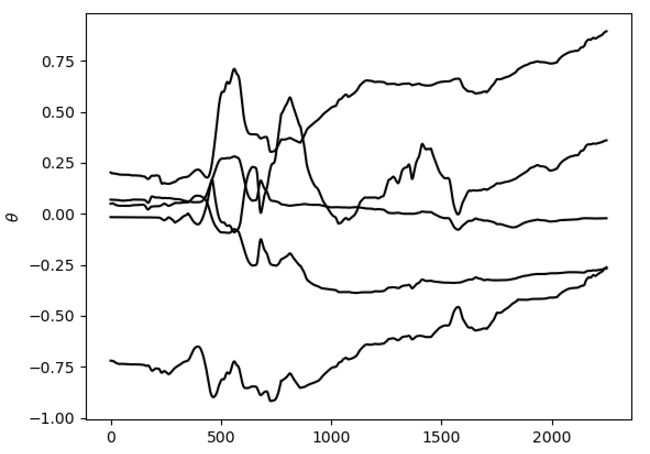
Only retained :
2909 Closed Bottom Temperature - Downstream Refiner (PV)
2916 Closed Bottom Temperature - Port 4 (PV)
1672 Closed Bottom Temperature - Port 8 (PV)
7485 Open Crown Temperature - Downstream Refiner (PV)
7520 Open Crown Temperature - Upstream Working End (PV)

Slide 35
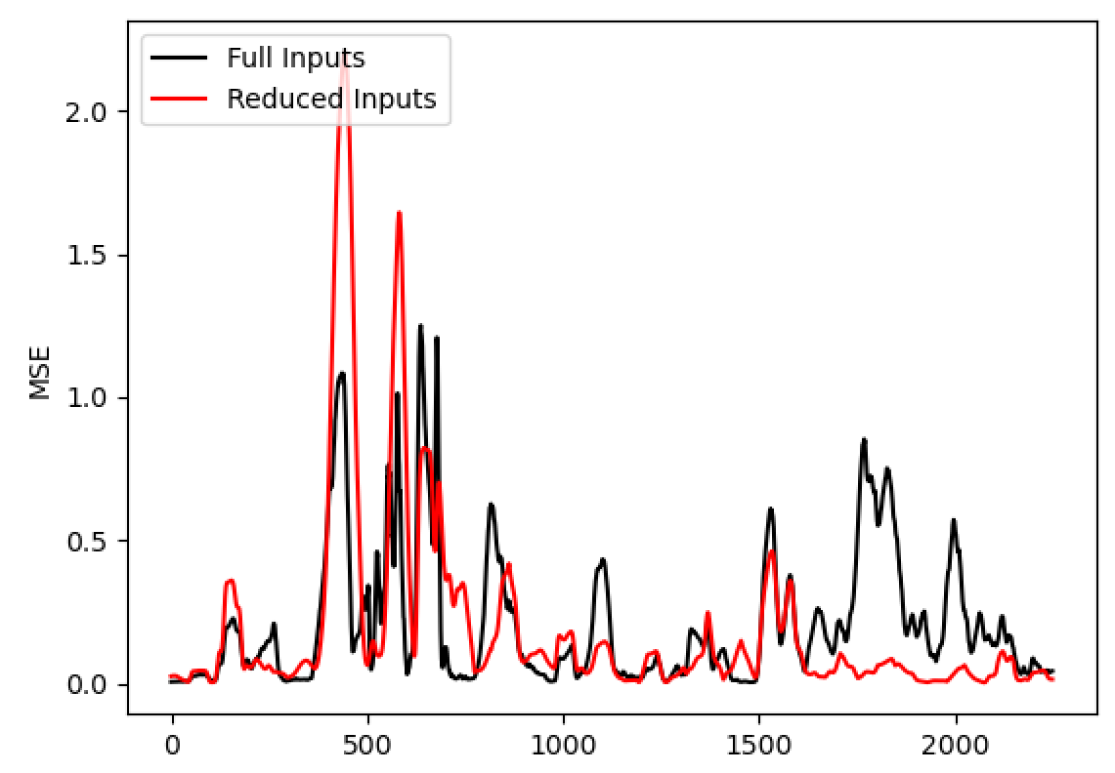

Slide 36
Very good here but also isn’t a particularly challenging piece of data

Slide 37
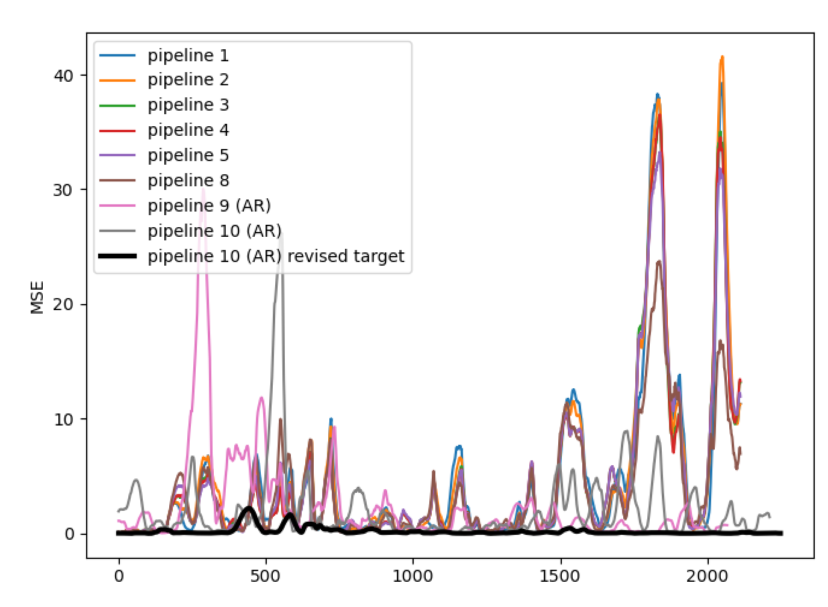
Pipeline | MSE
1 | 4.59
2 | 4.70
3 | 4.31
4 | 4.30
5 | 4.31
6 | 4.50
7 | 4.27
8 | 4.25
9 | 4.18
9 (AR) | 2.39
10 (AR) | 1.99
10 (AR) revised target | 0.19

Slide 38
Pipeline | MSE
1 | 4.59
2 | 4.70
3 | 4.31
4 | 4.30
5 | 4.31
6 | 4.50
7 | 4.27
8 | 4.25
9 | 4.18
9 (AR) | 2.39
10 (AR) | 1.99
10 (AR) revised target | 0.19
Again, very good here but also isn’t a particularly challenging piece of data

Slide 39
Next Steps
Questions:
We should continue with this ‘new’ furnace fault data?
Shorter Term:
Run the Linear Regression (autoregressive) model after eliminating correlated tags.
Video comparison of early and current approaches
Expand to validation data set
Comprehensive list of pre-processing parameters that could be tuned
Longer Term:
Recursive model structure (will still be very important; particularly as we look to 72 hours into the future)
Systematic tuning of parameters in pipeline
Enter Christmas break with the ‘pipeline’ finished; can return in January ready to focus purely on model development.

Slide 40
Thank you for your attention. ANY QUESTIONS?

